Slide 1


Unit-01
HTML
Web Designing
DU#2601CS102
CO : describe the basics of Internet, Web and Web Designing.
Prof. Dharmik P Vasiyani
Computer Engineering Department
dharmik.vasiyani@darshan.ac.in
9924664064

Slide 2

Outline
Introduction to WEB
  What is Internet?
  What is WWW?
How the WEB works?
HTTP Protocol
Introduction to Web Technologies
  HTML
  CSS
  JavaScript
  Bootstrap
  Material Design
Concepts of Effective Web Design
Web Design Issues
Planning a website
Effective Navigation
Looping

Slide 3
Course Outcomes
CO1: Describe the basics of the Internet, Web, and Web Designing.
CO2: Use HTML to design static web pages.
CO3: Apply basic styling to web pages using CSS.
CO4: Implement advanced CSS3 properties to enhance web pages.
CO5: Design elegant and responsive web pages using Bootstrap.

Slide 4
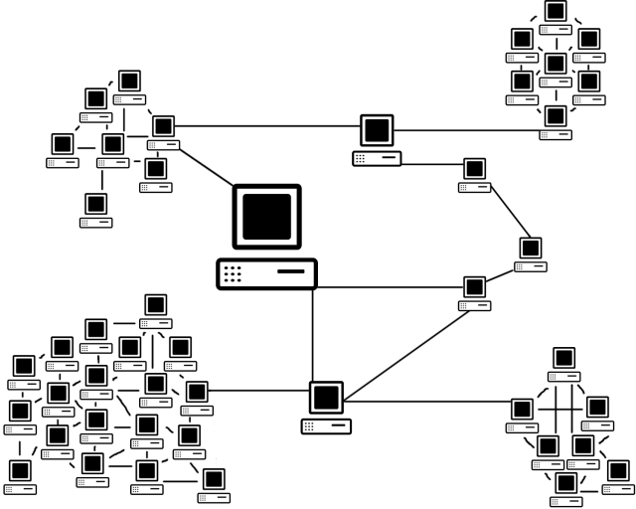
What is Internet?
The Internet is a massive network of networks, a networking infrastructure.
1969: The launch of ARPANET connected computers at four universities in the United States, proving that machines could communicate over distances.
It connects millions of computers together globally, forming a network in which any computer can communicate with any other computer as long as they are both connected to the Internet.
Information that travels over the Internet uses many different set of rules which are known as protocols(TCP/IP, SMTP, FTP , etc…).

Slide 5

Evolution & Mechanics of the Web (WWW)
The Historical Context
In 1989, Sir Tim Berners-Lee invented the World Wide Web while working at CERN.
It was designed to meet the demand for automated information-sharing between scientists.
How it Works
HTTP Protocol: The "language" used by browsers to request pages from servers.
HTML Documents: The structural format used to create web pages and link them via hypertext.
Client-Server Model: Your browser (Client) requests info, and a remote computer (Server) sends it back.
Prof. Dharmik P Vasiyani
#2601CS102 (WD) ⬥ Unit 01 – HTML
5

Slide 6
What is WWW?
WWW stands for World Wide Web.
A technical definition of the WWW is − All the resources and users on the Internet that are using HTTP.
HTTP stands for Hypertext Transfer Protocol which is a text-based request-response protocol.
HTTP is an application layer protocol that allows web-based applications to communicate and exchange the data.
HTTP is a TCP/IP(Transmission Control Protocol/Internet Protocol) based protocol, so it also is a connectionless and stateless protocol.
  After making the request, the client disconnects from the server, then when the response is ready the server re-establish the connection again and deliver the response.
HTTP is the protocol being used to transfer hypertext documents that makes the World Wide Web possible.

Slide 7
What is a Web Page?
Definition & Access
A web page is a document, commonly written in HTML, viewed in a browser.
Accessed by entering a URL into a browser's address bar.
May contain text, graphics, and hyperlinks to other pages and files.
HTML Notation
Document Structure: Semantic markup.
Formatting: Presentation markup.
History
First web page created at CERN by Tim Berners-Lee on August 6, 1991.
Visit the first website at info.cern.ch.

Slide 8



How the Web Works?
World Wide Web (WWW) use classical client / server architecture.
Server running Web Server Software (Apache, IIS, Tomcat, etc.)
Client running a Web Browser
HTTP
Page request
HTTP
Server response

Slide 9
HTTP request
The HTTP request message consist of following,
  A request line (e.g. GET /index.php HTTP1.1)
  Request header fields (e.g. Accept-Language: en)
  An empty line (CRLF)
  An optional message body
The request line and other header fields must end with CRLF (Carriage return, Line Feed) (/r/n)
A request line contains the method of request followed by the resource we want and at the end protocol version used.
  HTTP Request Methods: GET, POST, PUT, DELETE etc...

Slide 10
HTTP request
There are many request header fields available with HTTP Request, some of are listed below
  Accept : Media type(s) that is/are acceptable for the response. (e.g. Accept: text/html)
  Accept-Charset: Character sets that are acceptable. (e.g. Accept-Charset: utf-8)
  Date: The date and time at which the message was originated (e.g. Date: Tue, 15 Nov 1994 08:12:31 GMT)
  Host: The domain name of the server (e.g. Host: darshan.ac.in)
  User-Agent: details of the browser used (e.g. User-Agent: Mozilla/5.0 (Windows NT 10.0; Win64; x64) AppleWebKit/537.36 (KHTML, like Gecko) Chrome/88.0.4324.150 Safari/537.36)

Slide 11
HTTP Request (Example)
GET /index.php HTTP/1.1 |  | index.php is requested from server using GET method of HTTP version 1.1
User-Agent: Mozilla/5.0 (Windows NT 10.0; Win64; x64) AppleWebKit/537.36 (KHTML, like Gecko) Chrome/88.0.4324.150 Safari/537.36 |  | Version 5.0 of mozila browser is used on windows 10 (64 bit) while requesting the page from the server.
Host: www.darshan.ac.in |  | Host of the requested page is www.darshan.ac.in
Accept-Language: en-us |  | Client accepts US English locale while receiving the response from the server.
Accept: text/html |  | Client accepts text file containing the HTML in it while receiving the response from the server.

Slide 12
HTTP Response
After receiving and interpreting a HTTP request message, a server responds with an HTTP response message.
The HTTP response message consist of following,
  Status-Line (format= HTTP-Version SP Status-Code SP Reason-Phrase CRLF)
  *(( general-header | response-header | entity-header ) CRLF)
  An empty line (CRLF)
  An optional message body

Slide 13
HTTP Response
Status-Line consist of
  HTTP-Version, which can be HTTP/1.1
  Status-Code is a 3 digit code which is in below format
    1xx: Informational - Request received, continuing process
    2xx: Success - The action was successfully received, understood, and accepted
    3xx: Redirection - Further action must be taken in order to complete the request
    4xx: Client Error - The request contains bad syntax or cannot be fulfilled
    5xx: Server Error - The server failed to fulfill an apparently valid request
  Reason-Phase is a textual representation of the status code in human readable format.

Slide 14

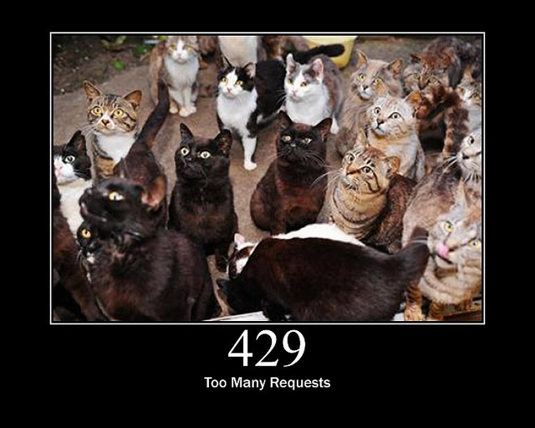
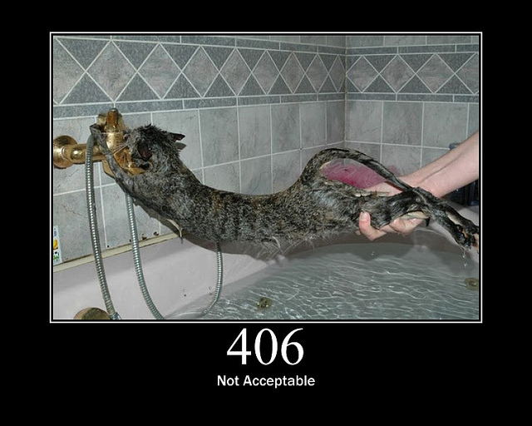
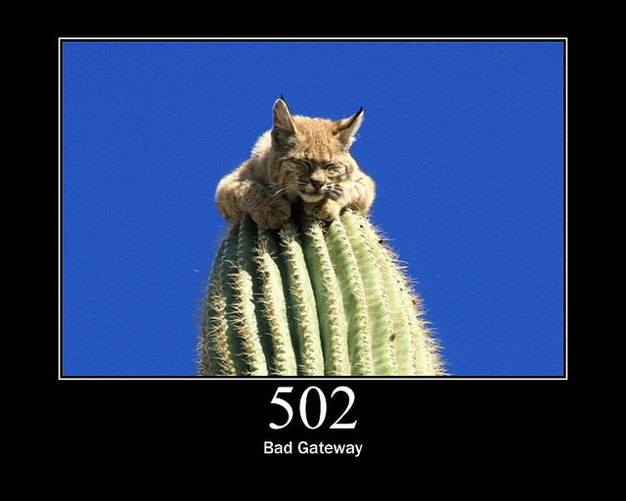
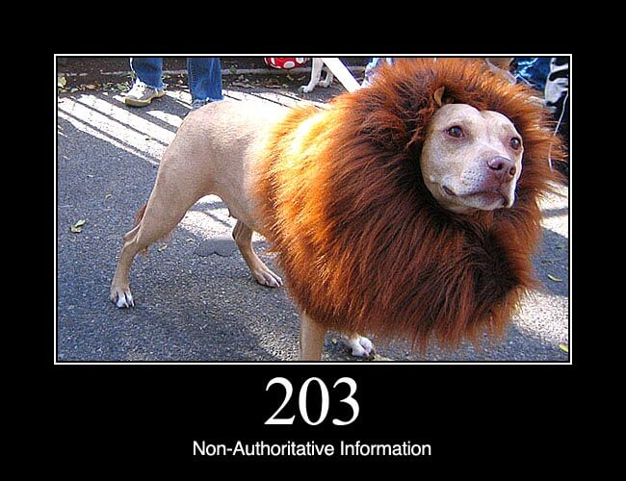
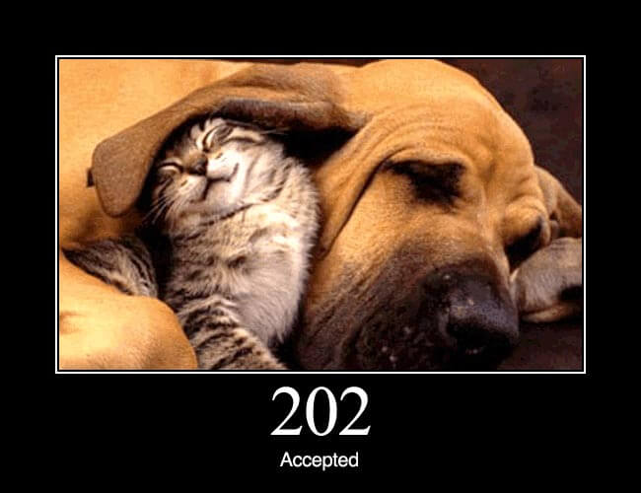
HTTP Status Codes with reason phrase
"100": Continue
"101": Switching Protocols
"200": OK
"201": Created
"202": Accepted
"203": Non-Authoritative Information
"204": No Content
"205": Reset Content
"206": Partial Content
"300": Multiple Choices
"301": Moved Permanently
"302": Found
"303": See Other
"304": Not Modified
"305": Use Proxy
"307": Temporary Redirect
"400": Bad Request
"401": Unauthorized
"402": Payment Required
"403": Forbidden
"404": Not Found
"405": Method Not Allowed
"406": Not Acceptable
"407": Proxy Authentication Required
"408": Request Time-out
"409": Conflict
"410": Gone
"411": Length Required
"412": Precondition Failed
"413": Request Entity Too Large
"414": Request-URI Too Large
"415": Unsupported Media Type
"416": Requested range not satisfiable
"417": Expectation Failed
"500": Internal Server Error
"501": Not Implemented
"502": Bad Gateway
"503": Service Unavailable
"504": Gateway Time-out
"505": HTTP Version not supported
Refer: https://www.w3.org/Protocols/rfc2616/rfc2616-sec6.html for more details on HTTP Status Code

Slide 15
HTTP Response (Example)
HTTP/1.1 200 OK |  | Response is 200 status code with OK message using HTTP1.1
Date: Mon, 27 Jul 2009 12:28:53 GMT |  | Response Date & Time
Server: Apache/2.2.14 (Win32) |  | Webserver used by server is Apache and version is 2.2.14 built for 32bit OS
Last-Modified: Wed, 22 Jul 2009 19:15:56 GMT |  | Last modified at Date & Time.
Content-Length: 88 |  | Content size of the response is 88 bytes
Content-Type: text/html |  | Content type of the response is text file containing HTML

Slide 16
Introduction to Web Technologies
HTML
  HTML stands for Hypertext Markup Language.
  It is used to design the front-end portion of web pages using a markup language.
  HTML is the combination of Hypertext and Markup language. Hypertext defines the link between the web pages. The markup language is used to define the text documentation within the tag which defines the structure of web pages.
CSS
  Cascading Style Sheets fondly referred to as CSS is a simply designed language intended to simplify the process of making web pages presentable.
  CSS allows you to apply styles to web pages.
  More importantly, CSS enables you to do this independent of the HTML that makes up each web page.
JavaScript
  JavaScript is a famous scripting language used to create magic on the sites to make the site interactive for the user.
  It is used to enhancing the functionality of a website to running cool games and web-based software.

Slide 17
Introduction to Web Technologies (Cont.)
Bootstrap
  Bootstrap is the most popular HTML, CSS, and JavaScript framework for developing responsive, mobile-first websites.
  Bootstrap is completely free to download and use! The primary purpose of adding it to a web project is to apply Bootstrap's choices of color, size, font and layout to that project.
  As such, the primary factor is whether the developers in charge find those choices to their liking.
  Once added to a project, Bootstrap provides basic style definitions for all HTML elements.
Material Design
  Material is a design system created by Google to help teams build high-quality digital experiences for Android, iOS, Flutter, and the web.
  Material Design is inspired by the physical world and its textures, including how they reflect light and cast shadows.

Slide 18
Concept of Effective Web Design
It's a good idea to first think about and design your site. That way, you'll give yourself direction and you'll need to reorganize less later.
To design your site:
  Figure out why you're creating this site. What do you want to convey?
  Think about your audience. How can you tailor your content to appeal to this audience? For example, should you add lots of graphics or is it more important that your page download quickly?
  How many pages will you need? What sort of structure would you like it to have? Do you want visitors to go through your site in a particular direction, or do you want to make it easy for them to explore in any direction?
  Sketch out your site on paper.
Devise a simple, consistent naming system for your pages, images and other external files.

Slide 19
Web Design Issues
Browser & Operating Systems
Bandwidth and Cache
Display Resolution
Look & Feel
Page Layout and Linking
Locating Information
Making Design user-Centric
Sitemap

Slide 20
a) Browser & Operating Systems
Web pages are written using different HTML tags and viewed in browser window.
The different browsers and their versions greatly affect the way a page is rendered, as different browsers sometimes interpret same HTML tag in a different way.
Different versions of HTML also support different sets of tags.
The support for different tags also varies across the different browsers and their versions.
Same browser may work slightly different on different operating system and hardware platform.
To make a web page portable, test it on different browsers on different operating systems.

Slide 21
b) Bandwidth and Cache
Users have different connection speed, i.e. bandwidth, to access the Web sites.
Connection speed plays an important role in designing web pages, if user has low bandwidth connection and a web page contains too many images, it takes more time to download.
Generally, users have no patience to wait for longer time than 10-15 seconds and move to other site without looking at contents of your web page.
Browser provides temporary memory called cache to store the graphics.
When user gives the URL of the web page for the first time, HTML file together with all the graphics files referred in a page is downloaded and displayed.

Slide 22
c) Display Resolution
Display resolution is another important factor affecting the Web page design, as we do not have any control on display resolution of the monitors on which user views our pages.
Display or screen resolution is measured in terms of pixels and common resolutions are 800 X 600 and 1024 X 786.
We have three choices for Web page design.
  Design a web page with fixed resolution.
  Make a flexible design using HTML table to fit into different resolution.
  If the page is displayed on a monitor with a higher resolution, the page is displayed on left hand side and some part on the right-hand side remains blank. We can use centered design to display page properly.
  Ideally we should use some frameworks for designing like Bootstrap/Material design.

Slide 23
d) Look & Feel & e) Page Layout and Linking
Look & Feel
  Look and feel of the website decides the overall appearance of the website.
  It includes all the design aspects such as
    Web site theme
    Web typography
    Graphics
    Visual structure
    Navigation etc…
Page Layout and Linking
  Website contains of individual web pages that are linked together using various navigational links.
  Page layout defines the visual structure of the page and divides the page area into different parts to present the information of varying importance.
  Page layout allows the designer to distribute the contents on a page such that visitor can view it easily and find necessary details.

Slide 24
f) Locating Information & g) Making Design User-Centric
Locating Information
  Webpage is viewed on a computer screen and the screen can be divided into five major areas such as center, top, right, bottom and left in this particular order.
  The first major area of importance in terms of users viewing pattern is the center, then top, right, bottom and left in this particular order
Making Design User-Centric
  It is very difficult for any Web designer to predict the exact behavior of the Web site users.
  However, idea of general behavior of common user helps in making design of the Web site user centric.
  Users either scan the information on the web page to find the section of their interest or read the information to get details.

Slide 25
h) Sitemap
A Sitemap is a model of a website's content designed to help both users and search engines navigate the site.
Many a times Web sites are too complex as there are a large number of sections and each section contains many pages.
It becomes difficult for visitors to quickly move from one part to other.
Once the user selects a particular section and pages in that section, user gets confused about where he/she is and where to go from there.
To make it simple, keep your hierarchy of information to few levels or provide the navigation bar on each page to jump directly to a particular section.

Slide 26
Planning a Website
The most important activity in a website development is planning.
To achieve higher success of the website in terms of user satisfaction, better planning is needed.
Before we start developing a website, we should ask question such as,
  Why are we developing this website?
  What do we achieve by developing this website?
  Who are the people who will use this website?
  What are the information contents?
  How are these contents organized? What are the possible ways?

Slide 27
Effective Navigation
The most important design element in the web design after page layout is navigation design.
Navigation means the ways to move from one page to another page in a Web site using hyperlinks provided on the page.
If navigation design is not proper then user feels the problem in moving around the pages in your site in a desired manner or gets confused and leaves the site.

Slide 28
Effective Navigation
Tips for Effective Navigation:
  Navigation links are either text based, i.e. a word or a phrase, or graphical, i.e. a image.
  Navigation links should be clear and meaningful.
  It should be consistent.
  Link should be understandable.
  Organize the links such that contents are grouped logically.
  Provide search link, if necessary, usually on top of the page.
  Use common links such as ‘about us’ or ‘Contact us’.
  Provide the way to return to first page.
  Provide the user with information regarding location.
  Horizontal navigation bar can be provided on each page to directly jump to any section.

Slide 29
Creating HTML Pages
An HTML file must have an .htm or .html file extension
HTML files can be created with text editors:
  NotePad, NotePad ++, PSPad
Or HTML editors (WYSIWYG Editors):
  Microsoft FrontPage
  Macromedia Dreamweaver
  Netscape Composer
  Visual Studio
Open any above mentioned editors and create a new file with .html extension and save the file.
After saving the file you can open the file with any Web Browser in order to view the output.

Slide 30
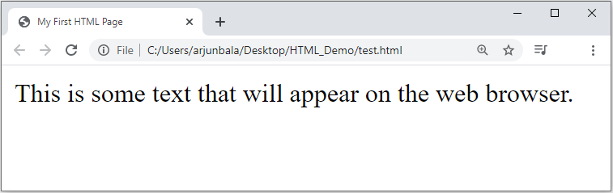
First HTML Page
test.html
<!DOCTYPE HTML>
<html>
<head>
<title>My First HTML Page</title>
</head>
<body>
<p>This is some text...</p>
</body>
</html>

Slide 31
HTML Structure
HTML is comprised of “elements” and “tags”
  Begins with <html> and ends with </html>
Elements (tags) are nested one inside another:
Tags have attributes:
HTML describes structure using two main sections: <head> and <body>
The HTML source code should be formatted to increase readability and facilitate debugging.
  Every block element should start on a new line.
  Every nested (block) element should be indented.
  Browsers ignore multiple whitespaces in the page source, so formatting is harmless.
For performance reasons, formatting can be sacrificed
<html> <head></head> <body></body> </html>
<img src="logo.jpg" alt="logo" />

Slide 32
First HTML Page
HTML header
<!DOCTYPE HTML>
<html>
<head>
<title>My First HTML Page</title>
</head>
<body>
<p>This is some text...</p>
</body>
</html>
Opening tag
Closing tag
HTML body

Slide 33
Basic HTML Tags
Headings
Paragraph
Fonts
List
Anchor Tag
Image
Table
Form

Slide 34
Headings
Headings are important because search engines use the headings to index the structure and content of your web pages.
  <h1> text </h1> -- largest of the six
  <h2> text </h2>
  <h3> text </h3>
  <h4> text </h4>
  <h5> text </h5>
  <h6> text </h6> -- smallest of the six
align="position" --left (default), center or right

Slide 35
<p> paragraph
The HTML <p> element represents a paragraph.
Paragraphs are usually represented in visual media as blocks of text separated from adjacent blocks by blank lines and/or first-line indentation, but HTML paragraphs can be any structural grouping of related content, such as images or form fields.
Paragraphs are block-level elements, and notably will automatically close if another block-level element is parsed before the closing </p> tag.
We can use align attribute of the paragraph tag to specify the text alignment for the text inside the paragraph, ex. <p align=“center”>our test</p>

Slide 36
Colors
We can use color values for mainly two attributes named bgcolor and color.
Possible values for the color are,
  many are predefined (red, blue, green, ...)
  all colors can be specified as a six character hexadecimal value: #RRGGBB
    #FF0000 – red
    #888888 – gray
    #00FF00 –green
    #000000 – black
For example, <body bgcolor=“#FF0000”> or <body bgcolor=“#888888”>

Slide 37
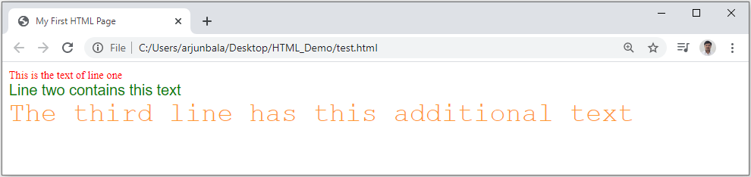
Fonts
The <font> tag specifies the font face, font size, and color of text.
The <font> tag is not supported in HTML5.
<font color="red" size="2" face="Times Roman">
This is the text of line one
</font>
<br/>
<font color="green" size="4" face="Arial">
Line two contains this text
</font>
<br/>
<font color="#FF9933" size="6" face="Courier">
The third line has this additional text
</font>

Slide 38
List
Ordered List
  Block-A
  Block-B
  Block-C
  Block-D
Unordered List
  Block-A
  Block-B
  Block-C
  Block-D
Defination List
  Block-A
  Block-B
  Block-C
  Block-D
  Block-A
  Block-B
  Block-C
  Block-D
  Block-A
  Block-B
  Block-C
  Block-D
  Block-A
  Block-B
  Block-C
  Block-D
  Block-A
  Block-B
  Block-C
  Block-D
  Block-A
  Block-B
  Block-C
  Block-D
HTML
Hyper Text Markup Language
WWW
World Wide Web

Slide 39
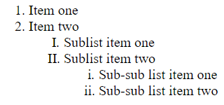
Ordered List (OL)
<ol>
<li> Item one </li>
<li> Item two </li>
<ol type="I">
<li> Sublist item one </li>
<li> Sublist item two </li>
<ol type="i">
<li> Sub-sub list item one </li>
<li> Sub-sub list item two </li>
</ol>
</ol>
</ol>
Types:
Type = 1 (default)
Type = a
Type = A
Type = I
Type = i
Output

Slide 40
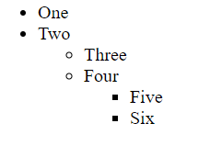
Unordered List (UL)
<ul>
<li> One </li>
<li> Two </li>
<ul type="circle">
<li> Three </li>
<li> Four </li>
<ul type="square">
<li> Five </li>
<li> Six </li>
</ul>
</ul>
</ul>
Types:
Type = disc (default)
Type = circle
Type = square
Output

Slide 41
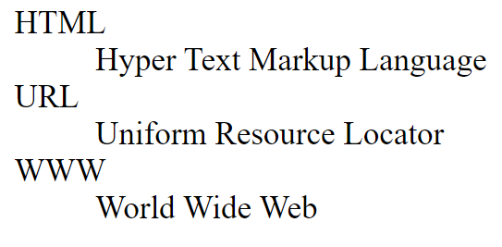
Definition / Description List (DL)
<dl>
<dt>HTML</dt>
<dd>Hyper Text Markup Language</dd>
<dt>URL</dt>
<dd>Uniform Resource Locator</dd>
<dt>WWW</dt>
<dd>World Wide Web</dd>
</dl>
Output

Slide 42
<a> Anchor Tag (Hyperlinks)
The <a> tag defines a hyperlink, which is used to link from one page to another.
An Anchor tag have 3 important attributes:
  the href attribute (hypertext reference) defines the target address of the document.
  the name attribute of the anchor tag can be used to enable users to “jump” to a specific point on a page.
  the target attribute specifies how the destination page or the target document should be opened. target="_ blank" is used for opening of the target page in a new tab.
Link to an absolute URL:
  Example, <a href="http://www.darshan.ac.in"> Darshan </a>.
Link to a relative URL:
  Example, <a href=“./index.php"> Home </a>.
Link to a section within a URL:
  Example, <a href=“#reference"> Reference Section. </a>.

Slide 43
Images
The HTML <img> element embeds an image into the document.
Syntax: <img src= "pathToImage" />
Attributes:
  the src attribute is required, and contains the path to the image we want to embed.
  the alt attribute holds a text description of the image, which isn't mandatory but is incredibly useful for accessibility (screen readers read this description out to their users so they know what the image means). Alt text is also displayed on the page if the image can't be loaded for some reason: for example, network errors, content blocking etc…
  the width & height attribute can be in units of pixels or percentage of page or frame.
  the align attribute (currently deprecated) will aligns the image with its surrounding context (Use the float and/or vertical-align CSS properties instead of this attribute).

Slide 44
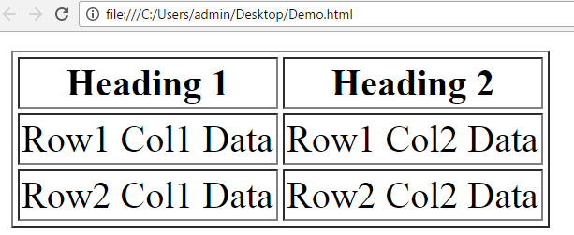
Table
<table border=1>
<caption>Table Caption</caption>
<tr>
<th>Heading1</th>
<th>Heading2</th>
</tr>
<tr>
<td>Row1 Col1 Data</td>
<td>Row1 Col2 Data</td>
</tr>
<tr>
<td>Row2 Col1 Data</td>
<td>Row2 Col2 Data</td>
</tr>
</table>
<table> table tag
<caption> optional table title
<tr> table row
<th> table header
<td> table data element
Output

Slide 45
META Tag
Metadata is data (information) about data.
The <meta> tag provides metadata about the HTML document.
Metadata will not be displayed on the page.
Meta elements are typically used to specify page description, keywords, author of the document, last modified and other metadata.
The metadata can be used by search engines (keywords), browsers (how to display content or reload page) or other web services.
Meta tag can be used to stop the page from being listed by search engines.
It can be used to set an expiry date so that the browser will fetch fresh copy from the server.
Meta tag can be used to stop the browser from caching a page.
1
<meta name="robots" content="noindex">
1
<meta http-equiv="expires" content=" Tue, 08 feb 2022 1:00:00 GMT">
1
<meta http-equiv="Cache-Control" content="no-store">

Slide 46
Meta Tag Attributes
Attribute | Value | Description
charset | character_set | Specifies the character encoding for the HTML document
name | author description keywords robots expires | Specifies a name for the metadata
http-equiv | content-type default-style refresh | Provides an HTTP header for the information/value of the content attribute
content | text | Gives the value associated with the http-equiv or name attribute
scheme | format/URI USA/Europe | Not supported in HTML5. Specifies a scheme to be used to interpret the value of the content attribute

Slide 47
HTML Formatting Tags
Tags | Description
<b> | Defines bold text
<i> | Defines italic text
<small> | Defines smaller text
<strong> | Defines important text
<sub> | The <sub> tag defines subscript text. Subscript text appears half a character below the baseline. Subscript text can be used for chemical formulas, like H₂O.
<sup> | The <sup> tag defines superscript text. Superscript text appears half a character above the baseline. Superscript text can be used for footnotes, like ^{WWW}
<mark> | Defines Highlighted text
<del> | Defines deleted text
<em> | Defines emphasized text
<tt> | The <tt> tag defines teletype text
<blink> | The <blink> tag is used for blinking the text.

Slide 48
HTML Forms
HTML forms are used to create GUIs on Web pages
  Usually the purpose is to ask the user for information
  The information is then sent back to the server
A form is an area that can contain form elements
  The syntax is: <form parameters> ...form elements... </form>
  Form elements include: buttons, checkboxes, text fields, radio buttons, drop-down menus, etc
    Other kinds of HTML tags can be mixed in with the form elements
  A form usually contains a Submit button to send the information in the form elements to the server
  The form’s parameters tell browser how to send the information to the server (there are two different ways it could be sent)

Slide 49
The <form> Tag
The <form arguments> ... </form> tag encloses form elements (and probably other HTML as well)
The arguments to form tell what to do with the user input
  action="url" (required)
    Specifies where to send the data when the Submit button is clicked
  method="get" (default)
    Form data is sent as a URL with ?form_data info appended to the end
    Can be used only if data is all ASCII and not more than 100 characters
  method="post"
    Form data is sent in the body of the URL request
    Cannot be bookmarked by most browsers
  target="target"
    Tells where to open the page sent as a result of the request
    target= _blank means open in a new window
    target= _top means use the same window

Slide 50
Form Elements
Input
Select
Textarea
Button
Label
Fieldset
Legend
Etc…
Input Types (HTML4)
text
password
checkbox
radio
submit
button
reset
file
Input Types (HTML5)
number
email
search
url
tel
range
color
date
time
datetime-local
month
week

Slide 51
Introduction to HTML5
It stands for Hypertext markup language version 5.
HTML5 is the latest version of HTML.
HTML5 is cooperation between the World Wide Web Consortium (W3C) and the Web Hypertext Application Technology Working Group (WHATWG).
What is new in HTML5?
  Support multimedia without flash player.
  So, we can include audio, video in our web page without installing flash player.
  We create drawing in our webpage using canvas without graphics software.
  We can trace user’s location.
  HTML5 coding structure is user friendly
  HTML5 program is run in latest version of Google chrome, Mozilla Firefox, Opera, Internet explorer 9.0

Slide 52
Semantic Elements of HTML5
A semantic element clearly describes its meaning to both the browser and the developer.
Examples of non-semantic elements: <div> and <span> - Tells nothing about its content.
Examples of semantic elements: <form> and <table> - Clearly defines its content.
Many semantic elements which is used to develop any webpages are:
  <header>
  <nav>
  <section>
  <article>
  <figure>
  <footer>
  <dialog>
  <aside>

Slide 53
HTML5 Form Validation
Form validation is a “technical process where a web-form checks if the information provided by a user is correct.”
The form will either alert the user that something is not in correct format and need to fix to proceed, or the form will be validated and the user will be able to continue with their process.
Form can be validated both in Client-Side as well as Server-Side, it is recommended to validate the form in both the side.
Form validation generally performs two functions.
  Basic Validation
    Emptiness
    Length Validation etc……
  Data Format Validation
    Secondly, the data that is entered must be checked for correct form and value.
    Email Validation
    Mobile Number Validation
    Enrollment Number Validation etc….

Slide 54
Cont.
We can use required attribute in order to stop user sending empty data to server.
We can use pattern attribute in order to force some format on user before sending the data to server.
We can use title attribute for custom error message.
1
<input type="text" name="txtName" required/>
1
<input type="text" name="txtName" pattern="[0-9]{10}"/>
1
<input type="text" name="txtName"
pattern="[0-9]{10}"
title="Please enter 10 digit mobile number"
required/>

Slide 55
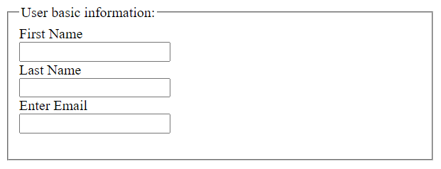
Fieldset and Legend
The HTML <fieldset> tag is used for grouping related form elements.
The use of this tag is optional while creating an HTML form but using <fieldset>, it is easy to understand the purpose of grouped elements of form.
The <legend> tag is used with the <fieldset> element as a first child to define the caption for the grouped related fields.
1
<form>
<fieldset>
<legend>User basic information:</legend>
<label>First Name</label><br>
<input type="text" name="fname"><br>
<label>Last Name</label><br>
<input type="text" name="lname"><br>
<label>Enter Email</label><br>
<input type="email" name="email"><br><br>
</fieldset>
</form>
Output

Slide 56
Media Tags
Video tag
Audio tag

Slide 57
Video Tag
The HTML <video> element is used to show a video on a web page.
The controls attribute adds video controls, like play, pause, and volume.
The width and height attributes are used to set width and height respectively.
The autoplay attribute start a video automatically.
The muted attribute will mute your video sound.
The <source> element allows you to specify alternative video files in src attribute which the browser may choose from. The browser will use the first recognized format.
The text written in between the <video> and </video> tags will display only if browser do not support the <video> element.
1
<video width="300" height="200" controls autoplay muted>
<source src="video.mp4" type="video/mp4">
<source src="video.ogg" type="video/ogg">
The video tag is not supported in your browser.
</video>

Slide 58
Audio Tag
The HTML <audio> element is used to play an audio file on a web page.
The controls attribute adds audio controls, like play, pause, and volume.
The autoplay attribute start a audio automatically.
The muted attribute will mute your audio sound.
The <source> element allows you to specify alternative audio files in src attribute which the browser may choose from. The browser will use the first recognized format.
The text written in between the <audio> and </audio> tags will display only if browser do not support the <audio> element.
1
<audio controls autoplay muted>
<source src="myaudio.ogg" type="audio/ogg">
<source src="myaudio.mp3" type="audio/mpeg">
The audio tag is not supported in your browser. </audio>

Slide 59

Web Design Issues — Common Problems to Avoid
Technical Issues
- Browser & Operating Systems
- Bandwidth and Cache
- Display Resolution
- Look & Feel
Page Layout and Linking
Locating Information
Sitemap
- No HTTPS security
Usability Issues
- Too many fonts and colors
- Poor color contrast
- Cluttered layout
- No clear navigation
- Pop-ups and intrusive ads
- Inconsistent styling
- No feedback on form errors
BOTTOM NOTE: Test your website on mobile, tablet AND desktop — 60%+ of users browse on mobile.
Prof. Dharmik P Vasiyani
#2301CS363 (WT-I) ⬥ Unit 01 – HTML

Slide 60

Web Designing
DU#2101CS104
Prof. Dharmik P Vasiynai
Computer Engineering Department
dharmik.vasiyani@darshan.ac.in
9924664064

